Slide 1

I.T
N.E.X.T
A presentation by LSS1

Slide 2






Our team
FONDEM YANNICK
NGENDA RODRICK
EMMANUEL
DESIGNER
CODER
RESEARCHER
BODZEMO JOEL
CALEH NOEL
ANALYST
DOCUMENTATION

Slide 3

Table of contents
01
02
03
04
05
06
Introduction
objectives
market opportunities
product demo
conclusion

Slide 4
INTRODUCTION
Challenge in the computer material industry.
Lack of a centralized platform for buying and maintaining them

Slide 5
GENERAL OBJECTIVE
Design and implement an application for the management of services of sales and maintenance of computer materials

Slide 6
01
User friendly interface
Implement a good user friendly web_base aplication

Slide 7
02
Admin dashboard
Design and implement a cool and simple to manipulate administrator dashboard to ease inventory, sale, maintainance service management

Slide 8
03
Service portal
Integrate a portal to help users access the different available products for sale and as well request a maintenance session

Slide 9
04
Security
Ensure users personal security by integrating user authentication to prevent the access of unauthorized users

Slide 10

BENEFITS
Enhance industry management
Increase access to diverse products
Streamlined inventory management for sellers
Convenient purchasing experience for users

Slide 11

Marketing opportunities

Slide 12
Market oportunities
Targeting small and medium sized business
Growing e-commerce market for computer hardware
Demand for efficient maintainance service
Streamlining processes and inventory management

Slide 13

PROJECT DEMO
file:///C:/Users/Dell/Desktop/rodrick/it-next/index.html

Slide 14
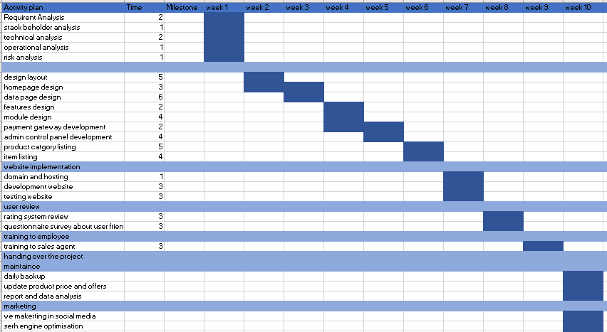
Project plan

Slide 15

A picture is worth a thousand words

Slide 16
Thanks

